Slide 1
Exception Handling - II
Lecture 25

Slide 2
Learning objectives
After the completion of today’s session you will be able to:
Illustrate the use throw and throws.
Differentiate between throw and throws keyword.
Analyze the use of finally.
Create your own exception

Slide 3
throw keyword
So far, you have only been catching exceptions that are thrown by the Java run-time system.
However, it is possible for your program to throw an exception explicitly, using the throw statement.
The general form of throw is shown here:
throw ThrowableInstance;

Slide 4
throw keyword – contd…
The flow of execution stops immediately after the throw statement; any subsequent statements are not executed.
The nearest enclosing try block is inspected to see if it has a catch statement that matches the type of exception.
If it does find a match, control is transferred to that statement.
If not, then the next enclosing try statement is inspected, and so on.
If no matching catch is found, then the default exception handler halts the program and prints the stack trace.

Slide 5
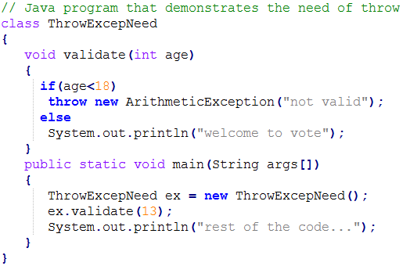
throw keyword example
Output

Slide 6
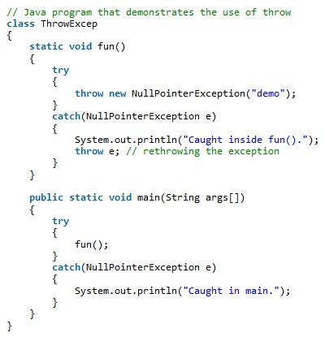

throw keyword example
Output

Slide 7
throws keyword
If a method is capable of causing an exception that it does not handle, it must specify this behavior so that callers of the method can guard themselves against that exception.
You do this by including a throws clause in the method’s declaration.
A throws clause lists the types of exceptions that a method might throw.
This is necessary for all exceptions, except those of type Error or RuntimeException, or any of their subclasses.
All other exceptions that a method can throw must be declared in the throws clause.
If they are not, a compile-time error will result.

Slide 8

throws keyword – contd…
General form

Slide 9
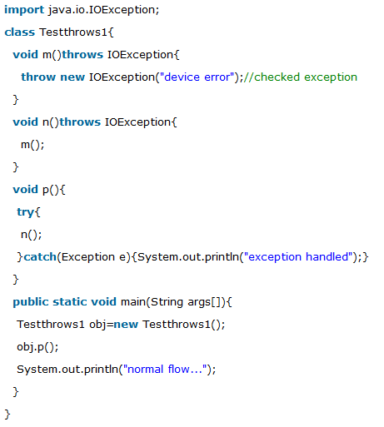

throws keyword example
Output

Slide 10
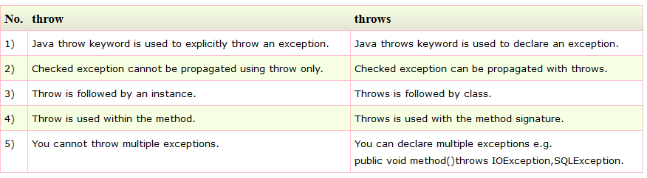
throw vs throws

Slide 11
finally keyword
finally creates a block of code that will be executed after a try /catch block has completed and before the code following the try/catch block.
The finally block will execute whether or not an exception is thrown.
If an exception is thrown, the finally block will execute even if no catch statement matches the exception.
Any time a method is about to return to the caller from inside a try/catch block, via an uncaught exception or an explicit return statement, the finally clause is also executed just before the method returns.
This can be useful for closing file handles and freeing up any other resources that might have been allocated at the beginning of a method with the intent of disposing of them before returning.
The finally clause is optional. However, each try statement requires at least one catch or a finally clause.

Slide 12
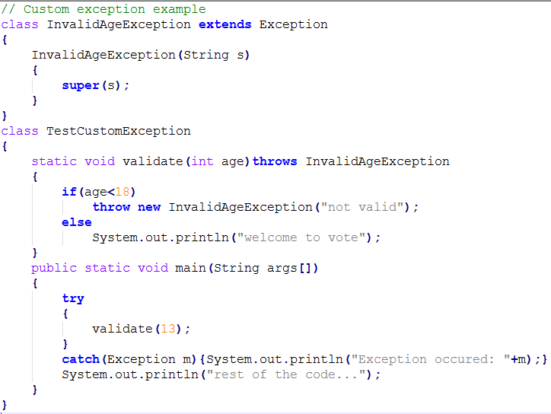
Creating your own exceptions – Example 1

Slide 13
Creating your own exceptions – Example 1
Output

Slide 14
Thanks

